Slide 1
Talking to our Children about Sexuality – Information for Sexual Health Educators
January 2017
Please contact sexualhealth@gov.nu.ca if you need support to teach this topic.

Slide 2
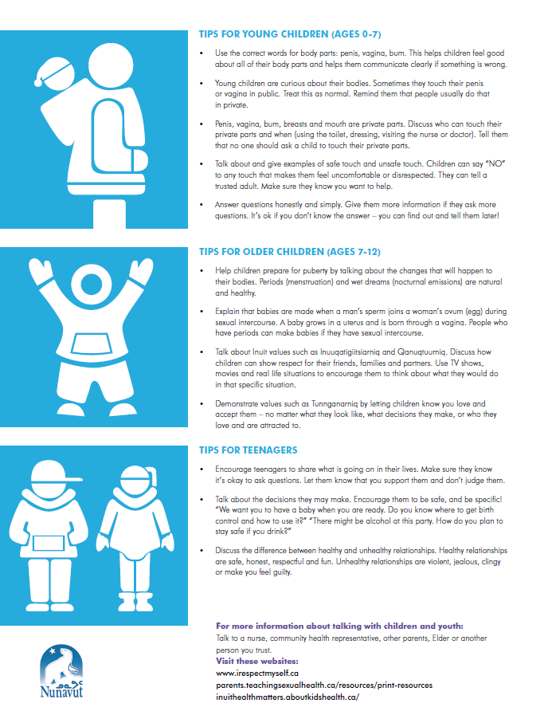
Nunavut-Specific Sexual Health Resource for Parents/ Caregivers
Available at: www.irespectmyself.ca, from local CHR, or by contacting sexualhealth@gov.nu.ca

Slide 3
Where to use this resource
Presentations at CPNP or other parent groups
A take-home resource from pre-natal or well-child visits
Leave in the waiting room for people to pick up
Nurses can give to parents at the health centre during well child checks or other visits
As a give-away at a health fair or store booth

Slide 4
Key Messages for Parent/ Caregiver Resource
Sexuality is not just about sex!
Talking about sexuality helps young people make decisions.
Kids of different ages need different information.
It’s important to talk to both boys and girls.
It might feel awkward at first, but it gets easier!

Slide 5
What is sexuality?
Values – what is important to us
Communication – how we talk to others
Relationships
Body Image and Self-Esteem – how we feel about ourselves
Anatomy and Physiology – body parts
Sexuality
Physical Expression - sex
Sexual orientation, gender roles, identity
Decision Making

Slide 6
Why do we need to start talking about sexuality when children are young?
Because sexuality is about communication, relationships, feelings, and self-esteem.
When we talk about communication, relationships, feelings, and self-esteem at a young age, children learn how to behave as adults.

Slide 7
Thoughts-Feelings-Behaviour Triangle
Thoughts
Feelings
Behaviours

Slide 8
Thoughts-Feelings-Behaviour Triangle
I’m ugly and stupid.
No one will ever love me. I don’t deserve a good relationship.
I’ll stay in this relationship, even though he/ she hurts me and won’t agree to use a condom, because it’s what I deserve and the best I can get.

Slide 9
Thoughts-Feelings-Behaviour Triangle
Boys are strong. Strength means not crying, and never showing weakness.
I can’t cry, I can’t be vulnerable, but I’m hurting.
Drinking to numb pain and hurt.
Violence, anger, frustration.

Slide 10
Thoughts-Feelings-Behaviour Triangle
Sex is dirty and something I’m not supposed to do. The words are shameful and embarrassing.
I’m ashamed of the way I feel. I feel like I can’t talk to anyone about this.
I can’t ask my parents for advice. I can’t talk to my partner about using a condom. I can’t ask a nurse about getting an STI test.

Slide 11
Changing the thoughts
What can parents, caregivers, and educators do?
Talk about the “extras” – self-esteem, body image, communication, relationships, feelings.
From a young age, tell children they are good and smart and deserve good things.

Slide 12
Thoughts-Feelings-Behaviour Triangle
I’m smart. I deserve good things. My parent/ teacher/ neighbour told me so.
I’m proud of who I am. I’m confident that I can keep myself safe. I want to BE someone!
I’m going to ask my partner to use a condom. I’m going to use birth control.

Slide 13
Talking to our children about sexual health can help them:
Be safe
Be happy
Be healthy
Have good relationships
Feel good about their bodies
Have children when they’re ready
Wait until they are ready to have sex
Notes:
Talking to children about sexuality doesn’t make them more likely to have sex.
If they are not learning from trusted adults, they are learning from TV, movies, music, and their friends. Often, the information they get from those sources is wrong. If we want them to have the right information, we need to talk to them.

Slide 14
Children and youth need different information at different ages

Slide 15
Ages 0-2
Name body parts
penis, vagina, bum, breasts

Slide 16
Ages 2-7
Public and private parts and activities.
Who can touch them, when. Be specific!
Safe and unsafe touch. Tell them to tell you, that you won’t be mad, and it’s not their fault.
Recognize and name feelings.
Answer questions simply.
Notes:
Be specific.
It’s ok if mummy or daddy helps you wipe after you go to the bathroom.
It’s ok if the nurse or doctor needs to check your private parts, as long as mummy or daddy are there.
It’s ok if someone is helping you get dressed.
If someone asks you to touch their private parts, that’s not ok.

Slide 17
Ages 7-12
How babies are made
Family values and expectations
Build self-esteem
Puberty (age 8-9)
Sexually transmitted infections and birth control (ages 10-12)
Notes:
Some family values might be – I want you to be older when you have sex. I want you to be married when you have sex. I want you to finish school before you have a baby. I want you to respect your partner.
Around this age, they start to hear talk about sexuality with their friends.

Slide 18
Ages 13-18
Start conversations
More detail - STIs and birth control
Healthy and unhealthy relationships
Decision making – be specific!
Build self-esteem
Promote safety
Build skills, including communication
Notes:
“Safer sex” = if someone decides to have sex, how can they make it as safe as possible? Use condoms. Use birth control. Get tested regularly for STIs. Talk to their partner.

Slide 19
Reminder about age of consent for sexual activity

Slide 20
Note for educators regarding consent for STI testing/ treatment and birth control:
Anyone, of any age, can come to the health centre for STI testing/ treatment and birth control.
If the person is young, the nurse may ask a few extra questions to be sure that the person is not being sexually abused and to be sure that the person understands the benefits and risks of treatment.

Slide 21
Our role as sexuality educators
Build our participants’
Knowledge
Skills
Confidence
How can we do this?

Slide 22
Best Ways to Teach
Find out what they already know
Make them feel good about themselves – recognize success!
Make it relevant to their life
Focus on good things – not just fear
Humour – get the giggles out
Drama/ Role Play
Telling stories
Yell out words to get comfortable saying them
Arts and crafts
Songs
Radio and TV script writing
Videos
Activities and games
Debates
Expert groups – have them teach themselves!
Storytelling
Hands-on
Pictures
Guest speakers
Field trips
Question box
Ask questions to check participant’s understanding

Slide 23
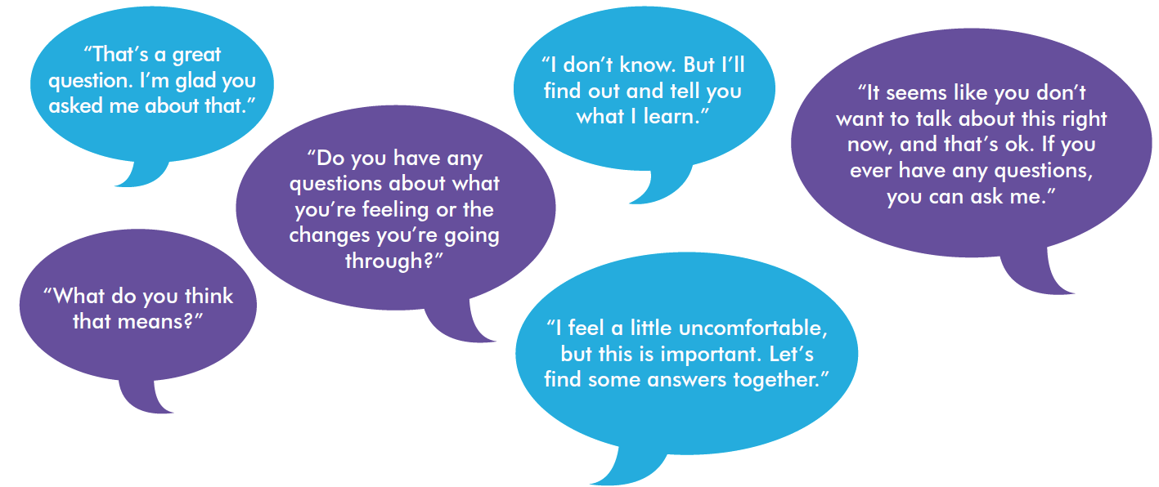
Tips for educators teaching sexual health
Be honest, open, and welcoming
Keep your sense of humour
Don’t worry if the conversation isn’t perfect
Use TV shows, music, movies, the news, and real life to start a conversation.

Slide 24
“People won’t remember what you said or what you did. They will remember how you made them feel.”

Slide 25
Activities for helping parents and caregivers talk to children and youth about sexual health
Icebreaker – Trains, Mad Libs, Kleenex activity, Two Truths and a Lie
Think-Pair-Share
Videos
Gallery Walk
Teachable Moments

Slide 26
Consider…
Asking a respected Elder to come in and speak about the topic to share traditional knowledge and values.
Meet with the Elder in advance to discuss the topic and ensure appropriate, inclusive, and respectful sharing of knowledge. Consider whether there is any potential for hurt or harm in the information being shared.
After the Elder leaves, have a discussion with your group about similarities and differences between traditional and modern knowledge. Be prepared to answer questions with objective, factual, and up-to-date information.

Slide 27
Please review “Teaching Sexual Health – Background Information for Educators” at www.irespectmyself.ca.
Please check out the “Helping Parents” Classroom Presentation and Lesson Plan at www.irespectmyself.ca.
Want more information about talking to children and youth about sexuality?
www.irespectmyself.ca
http://parents.teachingsexualhealth.ca/topics/resources.html
www.inuithealthmatters.aboutkidshealth.ca/
http://www.upworthy.com/5-everyday-ways-to-teach-your-kids-about-consent
Red Cross Be Safe Kit (available in schools; training available online at: http://www.redcross.ca/how-we-help/violence--bullying-and-abuse-prevention/educators/child-abuse-and-neglect-prevention/program-for-young-children--be-safe--can-help-prevent-sexual-abuse-of-children)
http://www.ippf.org/sites/default/files/2016-10/Putting%20Sexuality%20back%20into%20Comprehensive%20Sexuality%20Education_0.pdf

