Slide 1

Uqaqatiginiq Nutaqqaptingnun mighaagun Nuliaqnikkut
Ublua:
Tuniyauhimayuq talvanga:

Slide 2
Ublumi Katimadjutikhavut
Ilitugilugit hunat kangiqhidjutivut uqautigiguptigu “nuliaqnikkut”, uvaluuniin “niliqinikkut aaniaqtailiniq”.
Ilitugilugit hunat uqaqtaghavut nutaqqaptingnun mighaagun nuliaqnikkut aalakiinun ukiuqaqtunun.
Uuktuqhimaalutit kiulugit apiqhuutit tapkua nutaqqat apiqhuutait.
Notes:
2

Slide 3
Katimaqatigiiktut Angigutait
Tamaita apiqhuutit naamaktut, quyaginaq.
Inuk atuqhimayaminik unipkaaqqat iluani uuma igluap, hamaniitukhaq.
Ihumaliugutigihimaitumik – tamapta uvaptingni pidjutiqaqtugut uvalu ukpigiyaptingniklu.
Inuklugihuiqlugu.
Quviahuklutit Ilihaqtangnik!
Takugungni una naunaitkut, uuktuqlutit kiulugu apiqhuut!
Notes:
Write the group agreement on a whiteboard/ chart paper and hang up in the room. If anyone doesn’t follow this agreement, you can say “I want to remind everyone about the group agreement we all agreed to at the beginning of the class”

Slide 4

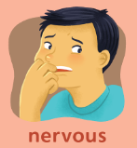
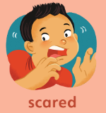
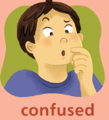

Aliahuutmik ulapkipkailutit
Akulialiuqlutit titiranuaqmun – qanuq mihingnautinun mighaagun uqaqatigiikniqmun nutaqqanun uvalu inulgamiqnun inuuhingni mighaagun nuliqinikkut aaniaqnaitumik?

Slide 5
Aliahuutmik ulapkipkailutit
Ililugu titirauyaqhimayat titiraqmun (aghuuqnaqluangitumik hamunga akhuuqnaqtumun) – qanuq akhuuqnaqtuq uqautigilugu nuliqinikkut aaniaqtailiniq nutaqqanun inulgamiqnunlu inuuhingni?
Akhuuqnangitut
Akhuuqnaqtut

Slide 6
Hunauva nuliaqnikkut aaniaqtailiniq aaniaqtailinikkut/nuliqinikkut?

Slide 7
Hunauva nuliaqnikkut aaniaqtailiniq aaniaqtailinikkut/nuliqinikkut?
Ukpigiyait – hunat akhuuqnaqtut uvaptingnun
Uqaqatigiikniq – qanuq uqautikput aalanun
Inuuqatigiikniq
Timikkut Qanuginiit uvalu Inmikkut Idjuhiit – qanuq mihingnautivut uvaptingnun
Timikkut uvalu Iqaiyaqnikkut – timip ilangit
Nuliqinikkut
Iqaiyaqnikkut Naunaiyautit (Qanuritmangat)
Nulliagiyainik aulamangangitnutlu, nuliaqniqmun, itquhiit
Ihumaliuqnikkut Piliuqniq

Slide 8
Huuq uqautigiyakhagiliqigu mighaagun nuliqiniq nutaqqat nutagautilugit?
Taimaali nuliqiniq pidjutiqaqtuq ilituginiqmik, inuuqatigiikniq, mihingnautit uvalu inmi idjuhiqmun.
Uqautigiguptigu tuhaqtitiniq, inuuqatigiikniq, mihingnautit, uvalu inmi idjuhit nukaqhiubluni, nutaqqat iliniaqtut qanuq idjuhiqaqlutik iningniqtun.

Slide 9
Nutaqqavut iningningugumik, piumayugut imaliuqlutik...
Notes:
Be Happy
Be Healthy
Be Safe
Have Good relationships
Have Children
Feel good about their bodies
Wait until they are ready to have sex

Slide 10
Uqaqatigilugit nutaqqavut mighaagun Nuliaqnikkut aaniaqtailinikkut ikayuqtavut nutaqqavut imailiugiangini:
  Qayaginiaqtut
  Quviahukniaqtut
  Inuuhiqattiaqniaqtut
  Nakuuyumik inuuqatiqaqniaqtut
  Mihingnautiqaqniatut nakuuyumik timimingni
  Nutaganiklutik upalingaigumik
  Nutaqilutik upalungaiqtinatik nuliagiami
Notes:
Doesn’t make them more likely to have sex.
If they are not learning from you, they are learning from TV, movies, music, and their friends. Often, the information they get from those sources is wrong. If we want them to have the right information, we need to talk to them.

Slide 11
Nutaqqat inulgamiitlu ihagiahuktut aalakiinik kangiqhidjutinik aktilaangitigut ukiungit

Slide 12
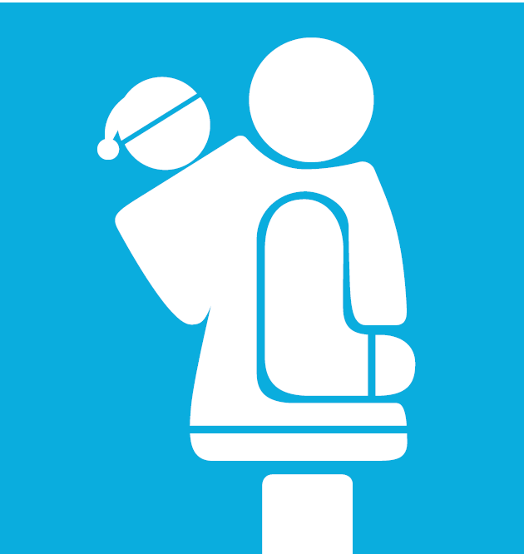
Ukiulgit 0min-2mun
Atiqlugit timip ilait
  uhuk, uttuk, nuluq, iviangiq
Notes:
Is this easy/ hard? Is it easier/ harder to use Inuktitut/ Innuinaqtun than English?

Slide 13
Ukiulgit 2min-7mun
Inuqangniqmi uvalu timivit hanalgutait uvalu hulidjutit.
Kia kahaktaaqtait, kakugu. Naunaiyattiaqhimalugit!
Ihuaqtut uvalu ihuangitut kahagaqniit. Uqautilugit uqaqlugit, ningalimaitutit, uvalu inmi pidjutigingitait.
Ilitagilugit uvalu atiqlugit mihingnautit.
Kiulugit apiqhuutit ayungnaitumik.
Notes:
Be specific.
It’s ok if mummy or daddy helps you wipe after you go to the bathroom.
It’s ok if the nurse or doctor needs to check your private parts, as long as mummy or daddy are there.
It’s ok if someone is helping you get dressed.
If someone asks you to touch their private parts, that’s not ok.

Slide 14
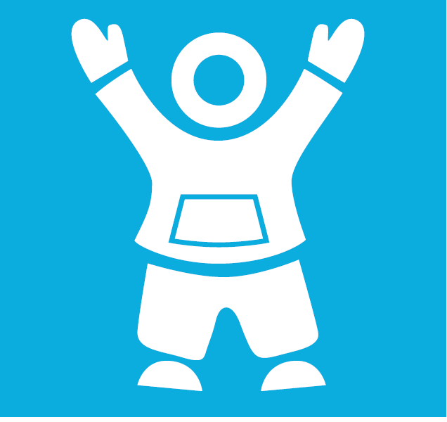
Ukiulgit 7min-12mun
Qanuq nutaganuat havaktauyut
Ilagiit ukpigiyait uvalu nigiugiyait
Havaklugit inmi idjuhiit
Iningninguqniq (ukiungit 8-9)
Nuliaqnikkut hiamitiqtut aaniagutit uvalu hingailaitkutit (ukiungit 10-12)
Notes:
Some family values might be – I want you to be older when you have sex. I want you to be married when you have sex. I want you to finish school before you have a baby. I want you to respect your partner.
Around this age, they start to hear things from their friends. Better to hear them an adult who cares about them, to make sure the information is correct.

Slide 15
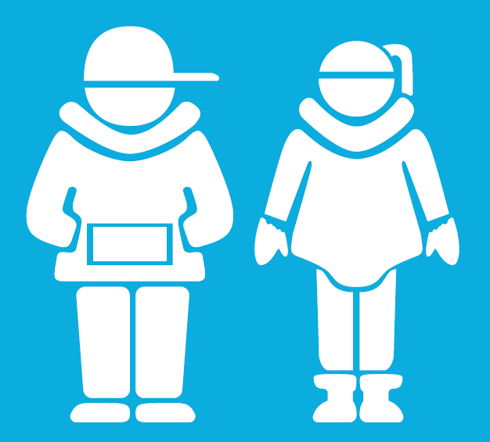
Ukiulgit 13min-18mun
Aulagutilugu uqaqatigiikniq
Amigaitunik naunaiyautinik - STIkut uvalu hingaiyailaitkutinik
Inuuhirittiarnikkut uvalu ihuuhiqluknikkut inuuqatigiikniq
Ihumaliuqnikkut Piliuqniq – naunaiqpiaqlugit!!
Havaklugit inmi idjuhiit
Akhuugutigilugu qayangnautit
Havakpalialiqlugit, ilauyut tuhaqtitinikkut
Notes:
“Safer sex” = if someone decides to have sex, how can they make it as safe as possible? Use condoms. Use birth control. Get tested regularly for STIs. Talk to their partner.

Slide 16
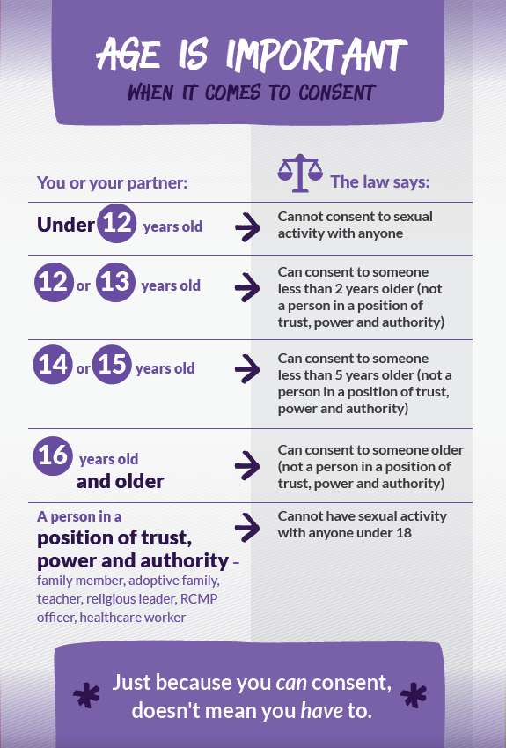
Ukiungit Angigutait haffumunga Nuliaqnikkut Huligjutinun

Slide 17
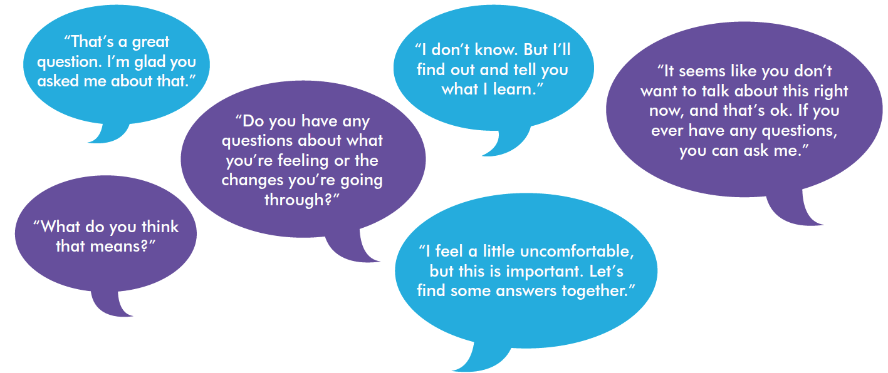
Atugahat Angayuqaanun
Itquumayumik, angmaumayumik uvalu tungahuknaqtumik
Pihimalugu quviahuutikkut
Ihumaalukhimaitumik uqautinikkut ihuaqluangitpat
Atuqlugit Tiiviit, atuqtuuyat, piksasiut, tuhaadjutit uvalu inuuhiqmi atuqpiaqtauyut uqautigilugit.
Uqaqlugit ilvit ilagiiknikkut ukpigiyatit uvalu nigiuktatit.

Slide 18
Hulidjutikhaq 1: Qungialiqivikmi Pihuklutit
Apiqhuutauluaqtut Nutaqqat Apigiyait!
Attautit ilihaqtut ukiungatigut ihuaqtunik kiudjutinik hapkununga apiqhuutinun:
  Apiqut 1
  Apiqut 2
  Apiqut 3
Notes:
You can do this as a large group, or in small groups – each group takes a question or two and comes up with some answers.

Slide 19
Hulidjutikhaq 2: Ilihaguminaqtunik Atuqtauyut
Attautit ilihaqtut tuniyauyut “ilihaguminaqtunik”atuqlutik pidjutainik
Ilihaqtut ihumaliuqlutik qanuq kiulugit pidjutait angayuqaangunikkut/munaqhiyut
Attautit ilihaqtut ulapqinguaqlugit inmi pidjutitik uvalu kiudjutikhait angitqiat ilihaqtut

Slide 20
Pamiqtaaqtaqqut nutaqqavut quviahuklutik, aaniaqnaitumik, uvalu qayangnaqtumik!

Slide 21
Kangiqhiattiagumaguvin
http://www.upworthy.com/5-everyday-ways-to-teach-your-kids-about-consent
http://parents.teachingsexualhealth.ca/topics/resources.html
www.inuithealthmatters.aboutkidshealth.ca/

Slide 22
Apiqhuutikhat?
Quana!

